Slide 1
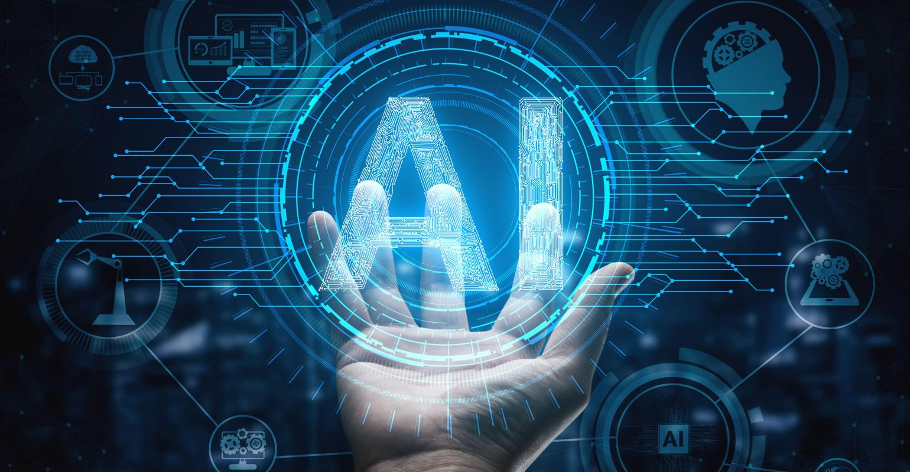

NAVIGATING ARTIFICIAL INTELLIGENCE IN THE PROFESSIONALWORKPLACE
NAVIGATING ARTIFICIAL INTELLIGENCE IN THE PROFESSIONALWORKPLACE
PE_C_TB1_G23 :
Meghna Martin
Damian Lopez
Istiak Mohammad
Lewis Babila
Ahmad Ahmad

Slide 2
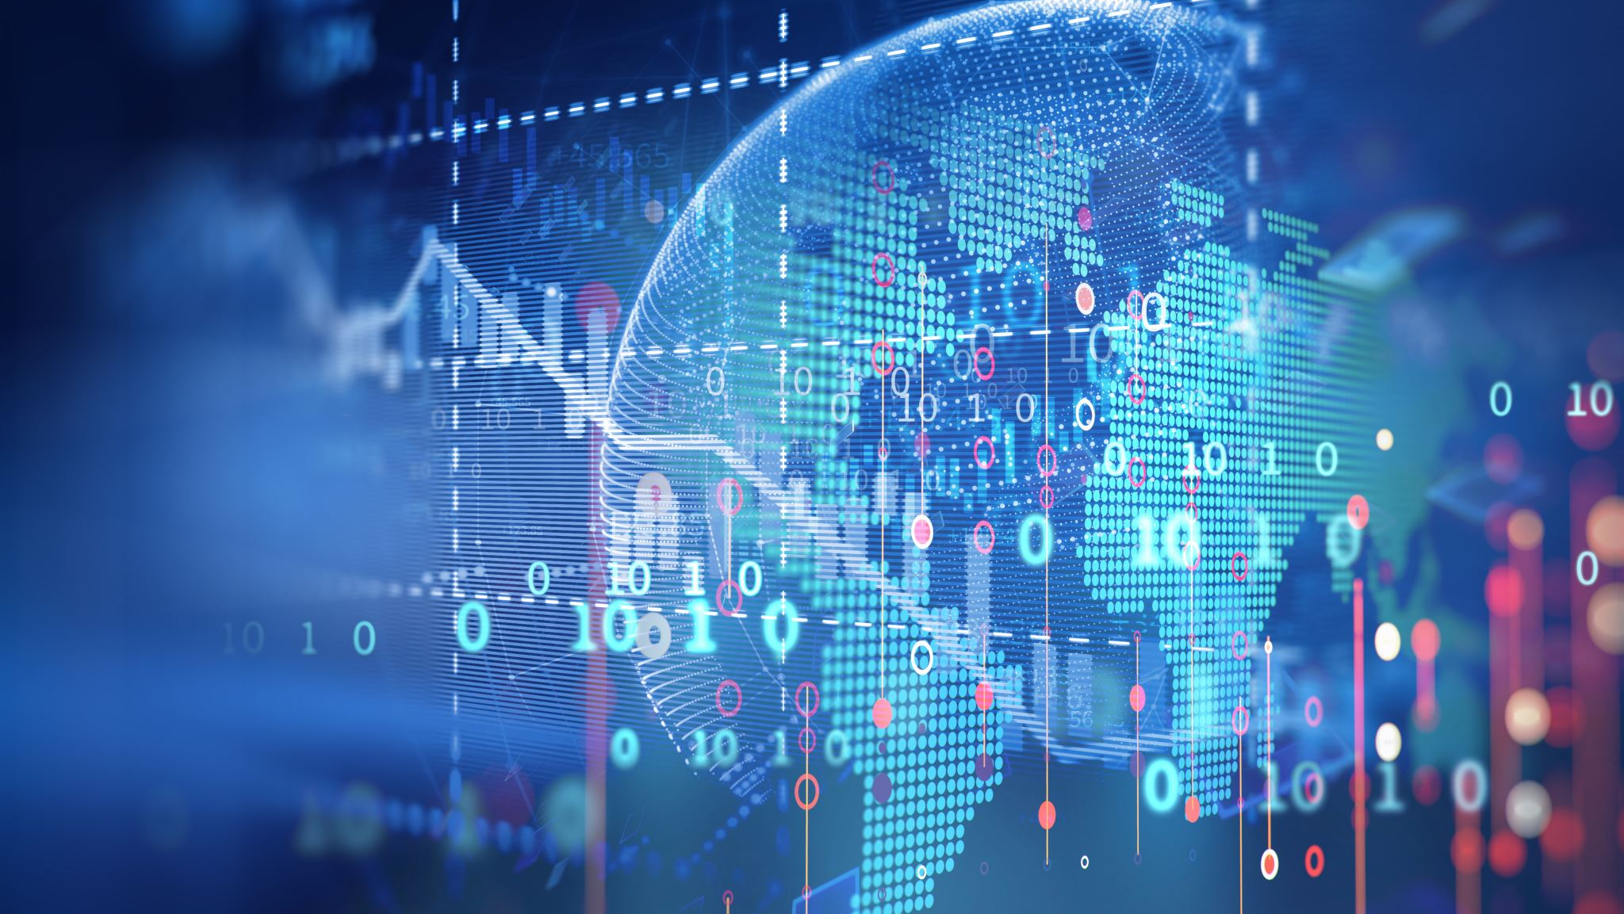
INTRODUCTION
With the development of AI, the world has never seen more integration with it and machine learning powered systems. This rapid development of AI forces us to consider different aspects of AI.
POLITICAL IMPACTS
ECONOMIC IMPACTS
SOCIETAL IMPACTS
ETHICAL IMPACTS
LEGAL IMPACTS

Slide 3

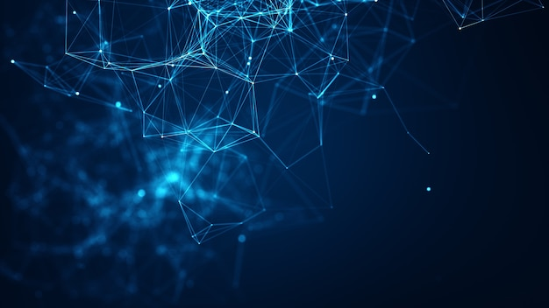


POLITICAL IMPACTS
As AI becomes more and more powerful, its impact is becoming broader and greater. How has this in result impacted the political system?
AI has provided a huge amount of data about human activities and behavior which could be biased. Such as the US presidential election which took place in 2016 won by Donald Trump, which used algorithmic promotion and complex data manipulation. Therefore, if we use AI for elections, it could simulate a human politician to manipulate human trust(Schneier, B. 2023).
However, despite the adverse impact AI has had in politics, what are the advantages?
Helping government agencies develop and deploy AI tools and creating AI-powered simulation models to assess policies and improve forecast.
It has also benefited the political system in policy analysis, electoral trends and data driven policymaking are just few of them which could be more efficient with AI assisted tools. although there are advantages the use of AI in politics should be transparent and fair and against biases and misuse.
(LSE’s Department of Philosophy et al. 2021)

Slide 4
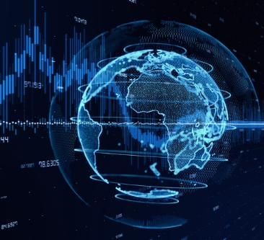

Economic Impact
How will AI impact the economy in UK ?
AI technology has developed substantially in the past decade and new AI technologies have transformed whole sectors of the economy through increased productivity and innovation.
These technologies have the potential to boost the economy significantly, perhaps by as much as 10% of GDP in the Uk by 2030.
(Department for Science, I. and T. 2021)

Slide 5
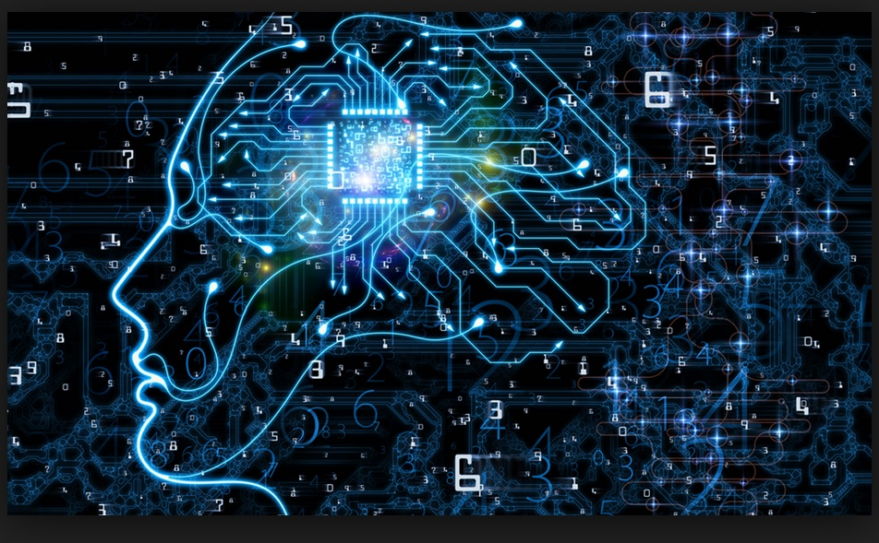
SOCIETAL IMPACTS
What are the benefits of AI on the Society and IT ?
It has led to the creation of new technologies, facilitates research and education, improves businesses and allows for more efficient workplaces and have a more significant effect on various aspects of the society such as healthcare and finance just to name a few.
What may be some adverse effects of AI?
An issue that has become prominent in society is that most people have started using AI as their main source of information, both to find and lookup information. However, there has been many instances where AI has been providing information that may not be accurate or reliable. In addition to this, it can be argued that AI displays opinions instead of factual information, and this is dangerous since it may mislead people with false information and mislead opinions.
Salokannel, P. (2023)
This Photo by Unknown author is licensed under CC BY-SA-NC.

Slide 6
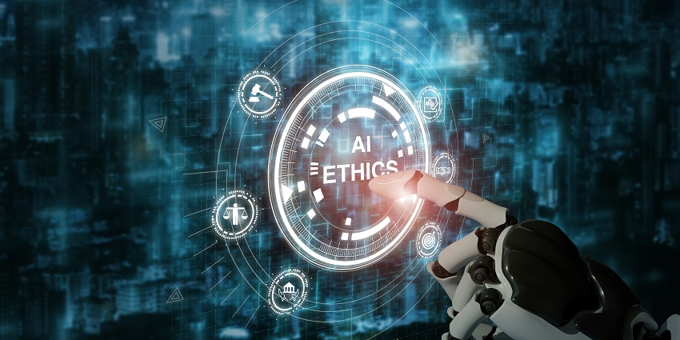
ETHICAL IMPACTS
What ethical concerns have risen from the increase of AI in the workplaces?
As this technology expands it leaves more space for ethical concerns to develop and the need for ethical guidelines and regulations to govern the evolution and utilization of AI.
As AI becomes a more useful tool in the workplace their moral implications has been a call for concern for companies. An AI tool used by Amazon was found to be biased , opposed to women, as it had been trained on resumes submitted by the company over the previous years, which were primarily men.
It has further highlighted the importance to both businesses and individuals to be aware of the potential risks that AI exhibits and what steps are required to mitigate these risks
Volet, C. (2023)

Slide 7
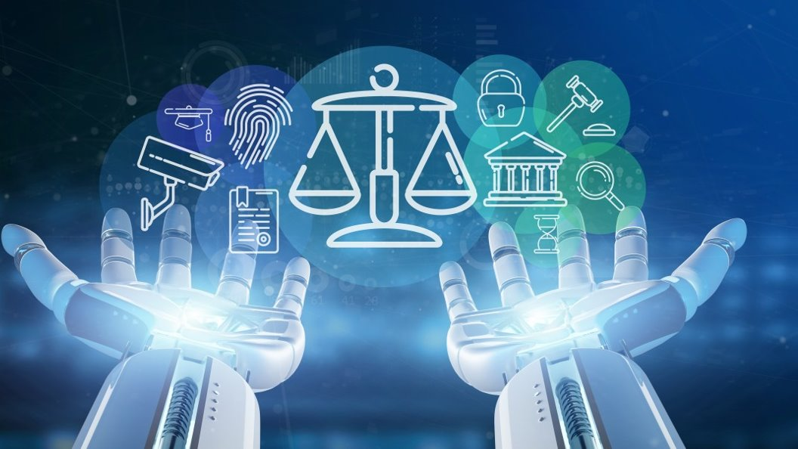
Legal Impact
The rapid growth of AI is requiring companies to confront an evolving host of questions across different areas of law. This includes privacy, cybersecurity, commercial and intellectual properties and many more.
It was revealed at a conference regarding the legal aspect of AI, how deeply artificial intelligence (AI) is influencing the legal spheres.
The conference makes it evident how AI will force us to change the rules so that it can fit in to ensure that we are protected by the problems created by AI, making sure laws and regulations are put in place so that if something goes wrong the appropriate steps are taken to resolve the problem.
Issues such as copyright and privacy are important areas which can be threatened with the development of AI thus it is necessary to evaluate the measures that needs to be taken to navigate through these challenges.
(Conference report: New technologies and AI – legal and practical aspects of the ecosystem of confidence)

Slide 8
Reference:
Schneier, B. (2023) Six ways that AI could change politics, MIT Technology Review. Available at: https://www.technologyreview.com/2023/07/28/1076756/six-ways-that-ai-could-change-politics/ (Accessed: 03 December 2023).
LSE’s Department of Philosophy et al. (2021) The ethics and politics of artificial intelligence, LSE Business Review. Available at: https://blogs.lse.ac.uk/businessreview/2021/07/14/the-ethics-and-politics-of-artificial-intelligence/ (Accessed: 03 December 2023).
Department for Science, I. and T. (2021) The potential impact of AI on UK employment and the demand for skills, GOV.UK. Available at: https://www.gov.uk/government/publications/the-potential-impact-of-ai-on-uk-employment-and-the-demand-for-skills (Accessed: 07 December 2023).
Salokannel, P. (2023). The impact of AI: How artificial intelligence is transforming society, 3DBear. Available at: https://www.3dbear.io/blog/the-impact-of-ai-how-artificial-intelligence-is-transforming-society (Accessed: 09 December 2023).
Volet, C. (2023) The impact of Artificial Intelligence (AI) on the Workplace, LinkedIn. Available at: https://www.linkedin.com/pulse/impact-artificial-intelligence-ai-workplace-charlotte-volet (Accessed: 13 December 2023).
(Conference report: New technologies and AI – legal and practical aspects of the ecosystem of confidence) . Available at: Full article: Conference report: New technologies and AI – legal and practical aspects of the ecosystem of confidence, 16–17 October 2020, Poland (online) (tandfonline.com)

